Slide 1
Module II: Artificial Neural Network

Slide 2
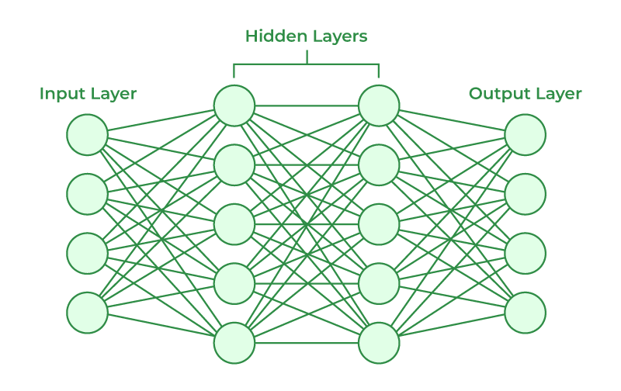
Neural Networks
A neural network is a artificial intelligence model designed to mimic the function and structure of the human brain. Neural networks are intricate networks of interconnected nodes, or neurons, that collaborate to tackle complicated problems.
Artificial Neural Networks contain artificial neurons which are called units. These units are arranged in a series of layers that together constitute the whole Artificial Neural Network in a system.
A layer can have only a dozen units or millions of units as this depends on how the complex neural networks will be required to learn the hidden patterns in the dataset.
Commonly, Artificial Neural Network has an input layer, an output layer as well as hidden layers. The input layer receives data from the outside world which the neural network needs to analyze or learn about. Then this data passes through one or multiple hidden layers that transform the input into data that is valuable for the output layer. Finally, the output layer provides an output in the form of a response of the Artificial Neural Networks to input data provided.
In the majority of neural networks, units are interconnected from one layer to another. Each of these connections has weights that determine the influence of one unit on another unit. As the data transfers from one unit to another, the neural network learns more and more about the data which eventually results in an output from the output layer.

Slide 3
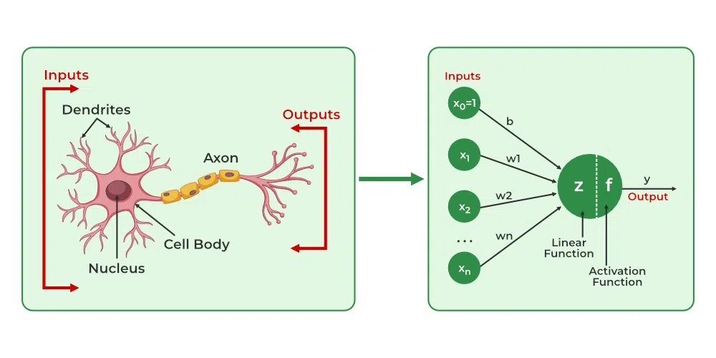
Artificial neurons vs Biological neurons
The concept of artificial neural networks comes from biological neurons found in animal brains So they share a lot of similarities in structure and function wise.
Structure: The structure of artificial neural networks is inspired by biological neurons. A biological neuron has a cell body or soma to process the impulses, dendrites to receive them, and an axon that transfers them to other neurons. The input nodes of artificial neural networks receive input signals, the hidden layer nodes compute these input signals, and the output layer nodes compute the final output by processing the hidden layer’s results using activation functions.
Synapses: Synapses are the links between biological neurons that enable the transmission of impulses from dendrites to the cell body. Synapses are the weights that join the one-layer nodes to the next-layer nodes in artificial neurons. The strength of the links is determined by the weight value.
Learning: In biological neurons, learning happens in the cell body nucleus or soma, which has a nucleus that helps to process the impulses. An action potential is produced and travels through the axons if the impulses are powerful enough to reach the threshold.
This becomes possible by synaptic plasticity, which represents the ability of synapses to become stronger or weaker over time in reaction to changes in their activity. In artificial neural networks, backpropagation is a technique used for learning, which adjusts the weights between nodes according to the error or differences between predicted and actual outcomes.
Biological Neuron | Artificial Neuron
Dendrite | Inputs
Cell nucleus or Soma | Nodes
Synapses | Weights
Axon | Output

Slide 4
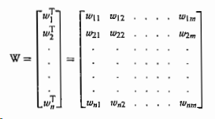
Weights
Weights: In the architecture of an ANN, each neuron is connected to other neurons by means of directed communication links, and each communication link is associated with weights.
The weights contain information about the input signal. This information is used by the net to solve a problem. The weight can be represented in terms of matrix.
The weight matrix can also be called connection matrix. To form a mathematical notation, it is assumed that there are "n" processing elements in an ANN and each processing element has exactly "m" adaptive weights.
where wi = [Wil, wi2,..., Wim], i = 1,2,..., n, is the weight vector of processing element and wij is the weight from processing element "" (source node) to processing element "" (destination node).
If the weight matrix W contains all the adaptive elements of an ANN, then the set of all W matrices will determine the set of all possible information processing configurations for this ANN. The ANN can be realized by finding an appropriate matrix W. Hence, the weights encode long-term memory (LTM) and the activation states of neurons encode short-term memory (STM) in a neural network.

Slide 5
Bias
The bias included in the network has its impact in calculating the net input. The bias is included by adding a component x = 1 to the input vector X. Thus, the input vector becomes
X = (1, X1,..., X., Χ)
y=mx+c
where x is the input, m is the weight, a is the bias and y is the output. Thus, bias plays a major role in determining the output of the network.
On the other hand Bias is like the intercept added in a linear equation. It is an additional parameter in the Neural Network which is used to adjust the output along with the weighted sum of the inputs to the neuron.
Therefore Bias is a constant which helps the model in a way that it can fit best for the given data. The processing done by a neuron is thus denoted as
output = sum (weights * inputs) + bias
Due to absence of bias, model will train over point passing through origin only, which is not in accordance with real-world scenario. Also with the introduction of bias, the model will become more flexible.
The bias can be of two types: positive bias and negative bias.
The positive bias helps in increasing the net input of the network and the negative bias helps in decreasing the net input of the network. Thus, as a result of the bias effect, the output of the network can be varied.

Slide 6
Comparison between Artificial Neural Network and Biological Neural Network
Features | Artificial Neural Network | Biological Neural Network
Definition | It is the mathematical model which is mainly inspired by the biological neuron system in the human brain. | It is also composed of several processing pieces known as neurons that are linked together via synapses.
Processing | Its processing was sequential and centralized. | It processes the information in a parallel and distributive manner.
Size | It is small in size. | It is large in size.
Control Mechanism | Its control unit keeps track of all computer-related operations. | All processing is managed centrally.
Rate | It processes the information at a faster speed. | It processes the information at a slow speed.
Complexity | It cannot perform complex pattern recognition. | The large quantity and complexity of the connections allow the brain to perform complicated tasks.
Feedback | It doesn't provide any feedback. | It provides feedback.
Fault tolerance | There is no fault tolerance. | It has fault tolerance.
Operating Environment | Its operating environment is well-defined and well-constrained | Its operating environment is poorly defined and unconstrained.
Memory | Its memory is separate from a processor, localized, and non-content addressable. | Its memory is integrated into the processor, distributed, and content-addressable.
Reliability | It is very vulnerable. | It is robust.
Learning | It has very accurate structures and formatted data. | They are tolerant to ambiguity.
Response time | Its response time is measured in milliseconds. | Its response time is measured in nanoseconds.

Slide 7
Advantages and Disadvantages of Neural Networks
Advantages of Neural Networks
Neural networks are widely used in many different applications because of their many benefits:
Adaptability: Neural networks are useful for activities where the link between inputs and outputs is complex or not well defined because they can adapt to new situations and learn from data.
Pattern Recognition: Their proficiency in pattern recognition renders them efficacious in tasks like as audio and image identification, natural language processing, and other intricate data patterns.
Parallel Processing: Because neural networks are capable of parallel processing by nature, they can process numerous jobs at once, which speeds up and improves the efficiency of computations.
Non-Linearity: Neural networks are able to model and comprehend complicated relationships in data by virtue of the non-linear activation functions found in neurons, which overcome the drawbacks of linear models.
Disadvantages of Neural Networks
Neural networks, while powerful, are not without drawbacks and difficulties:
Computational Intensity: Large neural network training can be a laborious and computationally demanding process that demands a lot of computing power.
Black box Nature: As “black box” models, neural networks pose a problem in important applications since it is difficult to understand how they make decisions.
Overfitting: Overfitting is a phenomenon in which neural networks commit training material to memory rather than identifying patterns in the data. Although regularization approaches help to alleviate this, the problem still exists.
Need for Large datasets: For efficient training, neural networks frequently need sizable, labeled datasets; otherwise, their performance may suffer from incomplete or skewed data.

Slide 8
Elements of Neural Network
Here are other elements of this network.
Input Layer : The input layer takes raw input from the domain. No computation is performed at this layer. Nodes here just pass on the information (features) to the hidden layer.
Hidden Layer: As the name suggests, the nodes of this layer are not exposed. They provide an abstraction to the neural network. The hidden layer performs all kinds of computation on the features entered through the input layer and transfers the result to the output layer.
Output Layer: It’s the final layer of the network that brings the information learned through the hidden layer and delivers the final value as a result.

Slide 9
The models of ANN are specified by the three basic entities namely:
1. the model's synaptic interconnections;
2. the training or learning rules adopted for updating and adjusting the connection weights;
3. their activation functions.
Connections
The neurons should be visualized for their arrangements in layers. An ANN consists of a set of highly inter- connected processing elements (neurons) such that each processing element output is found to be connected through weights to the other processing elements or to itself; delay lead and lag-free connections are allowed.
Hence, the arrangements of these processing elements and the geometry of their interconnections are essential for an ANN. The point where the connection originates and terminates should be noted, and the function of each processing element in an ANN should be specified. Besides the simple neuron shown in Figure??, there exist several other types of neural network connections.
The arrangement of neurons to form layers and the connection pattern formed within and between layers is called the network architecture. There exist five basic types of neuron connection architectures. They are:
1. single-layer feed-forward network;
2. multilayer feed-forward network;
3. single node with its own feedback;
4. single-layer recurrent network;
5. multilayer recurrent network.

Slide 10
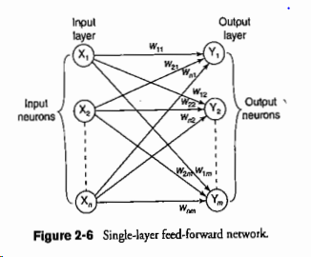
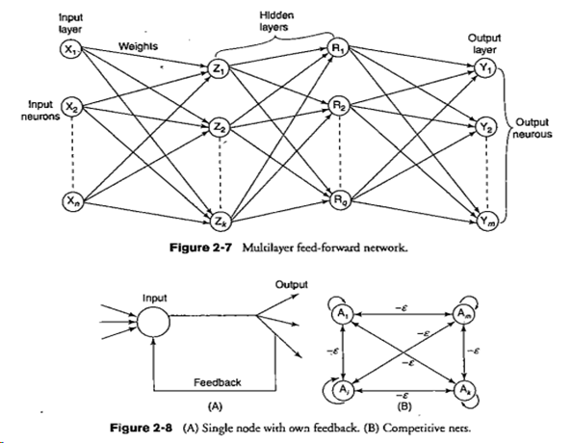
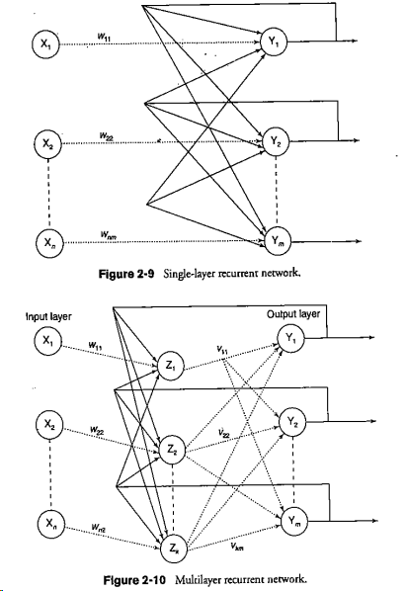
Types of Connections

Slide 11
Training or Learning Rules

Slide 12
Supervised Machine Learning
Supervised learning is the types of machine learning in which machines are trained using well "labelled" training data, and on basis of that data, machines predict the output. The labelled data means some input data is already tagged with the correct output.
In supervised learning, the training data provided to the machines work as the supervisor that teaches the machines to predict the output correctly. It applies the same concept as a student learns in the supervision of the teacher.
Supervised learning is a process of providing input data as well as correct output data to the machine learning model. The aim of a supervised learning algorithm is to find a mapping function to map the input variable(x) with the output variable(y).
In the real-world, supervised learning can be used for Risk Assessment, Image classification, Fraud Detection, spam filtering, etc.

Slide 13
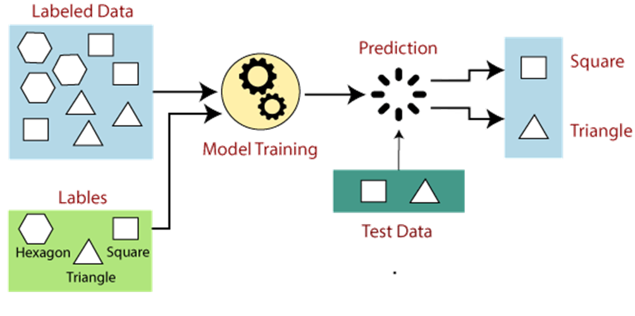
Example of Supervised Machine Learning
Suppose we have a dataset of different types of shapes which includes square, rectangle, triangle, and Polygon. Now the first step is that we need to train the model for each shape.
If the given shape has four sides, and all the sides are equal, then it will be labelled as a Square.
If the given shape has three sides, then it will be labelled as a triangle.
If the given shape has six equal sides then it will be labelled as hexagon.
Now, after training, we test our model using the test set, and the task of the model is to identify the shape.
The machine is already trained on all types of shapes, and when it finds a new shape, it classifies the shape on the bases of a number of sides, and predicts the output.

Slide 14
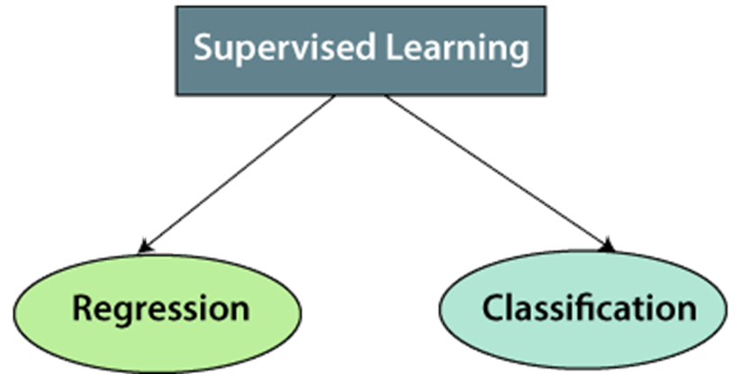
Types of Supervised Machine learning Algorithms
Regression
Regression algorithms are used if there is a relationship between the input variable and the output variable. It is used for the prediction of continuous variables, such as Weather forecasting, Market Trends, etc. Below are some popular Regression algorithms which come under supervised learning:
Linear Regression
Regression Trees
Non-Linear Regression
Bayesian Linear Regression
Polynomial Regression

Slide 15
Types of Supervised Machine learning Algorithms
Classification algorithms are used when the output variable is categorical, which means there are two classes such as Yes-No, Male-Female, True-false, etc.
Spam Filtering,
Random Forest
Decision Trees
Logistic Regression
Support vector Machines

Slide 16
Advantages and Disadvantages of Supervised learning
Advantages :
With the help of supervised learning, the model can predict the output on the basis of prior experiences.
In supervised learning, we can have an exact idea about the classes of objects.
Supervised learning model helps us to solve various real-world problems such as fraud detection, spam filtering, etc.
Disadvantages :
Supervised learning models are not suitable for handling the complex tasks.
Supervised learning cannot predict the correct output if the test data is different from the training dataset.
Training required lots of computation times.
In supervised learning, we need enough knowledge about the classes of object.

Slide 17
Applications of Supervised Learning
Image Segmentation: Supervised Learning algorithms are used in image segmentation. In this process, image classification is performed on different image data with pre-defined labels.
Medical Diagnosis: Supervised algorithms are also used in the medical field for diagnosis purposes. It is done by using medical images and past labelled data with labels for disease conditions. With such a process, the machine can identify a disease for the new patients.
Fraud Detection - Supervised Learning classification algorithms are used for identifying fraud transactions, fraud customers, etc. It is done by using historic data to identify the patterns that can lead to possible fraud.
Spam detection - In spam detection & filtering, classification algorithms are used. These algorithms classify an email as spam or not spam. The spam emails are sent to the spam folder.
Speech Recognition - Supervised learning algorithms are also used in speech recognition. The algorithm is trained with voice data, and various identifications can be done using the same, such as voice-activated passwords, voice commands, etc.

Slide 18
Unsupervised Learning
As the name suggests, unsupervised learning is a machine learning technique in which models are not supervised using training dataset. Instead, models itself find the hidden patterns and insights from the given data. It can be compared to learning which takes place in the human brain while learning new things. It can be defined as:
Unsupervised learning is a type of machine learning in which models are trained using unlabeled dataset and are allowed to act on that data without any supervision.
Unsupervised learning cannot be directly applied to a regression or classification problem because unlike supervised learning, we have the input data but no corresponding output data.
The goal of unsupervised learning is to find the underlying structure of dataset, group that data according to similarities, and represent that dataset in a compressed format.

Slide 19
Why use Unsupervised Learning?
Below are some main reasons which describe the importance of Unsupervised Learning:
Unsupervised learning is helpful for finding useful insights from the data.
Unsupervised learning is much similar as a human learns to think by their own experiences, which makes it closer to the real AI.
Unsupervised learning works on unlabeled and uncategorized data which make unsupervised learning more important.
In real-world, we do not always have input data with the corresponding output so to solve such cases, we need unsupervised learning.

Slide 20
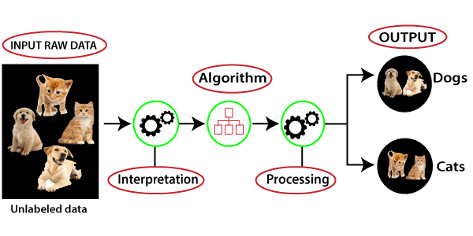
Example Unsupervised Learning
Suppose the unsupervised learning algorithm is given an input dataset containing images of different types of cats and dogs. The algorithm is never trained upon the given dataset, which means it does not have any idea about the features of the dataset. The task of the unsupervised learning algorithm is to identify the image features on their own. Unsupervised learning algorithm will perform this task by clustering the image dataset into the groups according to similarities between images.
Here, we have taken an unlabeled input data, which means it is not categorized and corresponding outputs are also not given. Now, this unlabeled input data is fed to the machine learning model in order to train it. Firstly, it will interpret the raw data to find the hidden patterns from the data and then will apply suitable algorithms such as k-means clustering, Decision tree, etc.
Once it applies the suitable algorithm, the algorithm divides the data objects into groups according to the similarities and difference between the objects.

Slide 21
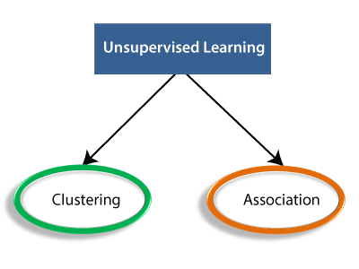
Types of Unsupervised Learning Algorithm:
Unsupervised Learning algorithms:
Below is the list of some popular unsupervised learning algorithms:
K-means clustering
KNN (k-nearest neighbors)
Hierarchal clustering
Anomaly detection
Neural Networks
Principle Component Analysis
Independent Component Analysis
Apriori algorithm
Singular value decomposition
Clustering: Clustering is a method of grouping the objects into clusters such that objects with most similarities remains into a group and has less or no similarities with the objects of another group. Cluster analysis finds the commonalities between the data objects and categorizes them as per the presence and absence of those commonalities.
Association: An association rule is an unsupervised learning method which is used for finding the relationships between variables in the large database. It determines the set of items that occurs together in the dataset. Association rule makes marketing strategy more effective. Such as people who buy X item (suppose a bread) are also tend to purchase Y (Butter/Jam) item. A typical example of Association rule is Market Basket Analysis.

Slide 22
Advantages and Disadvantages of Unsupervised learning
Advantages
Disadvantages
Unsupervised learning is used for more complex tasks as compared to supervised learning because, in unsupervised learning, we don't have labeled input data.
Unsupervised learning is preferable as it is easy to get unlabeled data in comparison to labeled data.
Unsupervised learning is intrinsically more difficult than supervised learning as it does not have corresponding output.
The result of the unsupervised learning algorithm might be less accurate as input data is not labeled, and algorithms do not know the exact output in advance.

Slide 23
Applications of Unsupervised Learning
Network Analysis: Unsupervised learning is used for identifying plagiarism and copyright in document network analysis of text data for scholarly articles.
Recommendation Systems: Recommendation systems widely use unsupervised learning techniques for building recommendation applications for different web applications and e-commerce websites.
Anomaly Detection: Anomaly detection is a popular application of unsupervised learning, which can identify unusual data points within the dataset. It is used to discover fraudulent transactions.
Singular Value Decomposition: Singular Value Decomposition or SVD is used to extract particular information from the database. For example, extracting information of each user located at a particular location.

Slide 24
Semi-Supervised learning
Semi-Supervised learning is a type of Machine Learning algorithm that represents the intermediate ground between Supervised and Unsupervised learning algorithms. It uses the combination of labeled and unlabeled datasets during the training period. It represents the intermediate ground between Supervised (With Labelled training data) and Unsupervised learning (with no labelled training data) algorithms and uses the combination of labelled and unlabeled datasets during the training period.
Although Semi-supervised learning is the middle ground between supervised and unsupervised learning and operates on the data that consists of a few labels, it mostly consists of unlabeled data. As labels are costly, but for corporate purposes, they may have few labels. It is completely different from supervised and unsupervised learning as they are based on the presence & absence of labels.
To overcome the drawbacks of supervised learning and unsupervised learning algorithms, the concept of Semi-supervised learning is introduced. The main aim of semi-supervised learning is to effectively use all the available data, rather than only labelled data like in supervised learning. Initially, similar data is clustered along with an unsupervised learning algorithm, and further, it helps to label the unlabeled data into labelled data. It is because labelled data is a comparatively more expensive acquisition than unlabeled data.
We can imagine these algorithms with an example. Supervised learning is where a student is under the supervision of an instructor at home and college. Further, if that student is self-analysing the same concept without any help from the instructor, it comes under unsupervised learning. Under semi-supervised learning, the student has to revise himself after analyzing the same concept under the guidance of an instructor at college.

Slide 25
Working of Semi-Supervised Learning
Semi-supervised learning uses pseudo labeling to train the model with less labeled training data than supervised learning. The process can combine various neural network models and training ways. The whole working of semi-supervised learning is explained in the below points:
Firstly, it trains the model with less amount of training data similar to the supervised learning models. The training continues until the model gives accurate results.
The algorithms use the unlabeled dataset with pseudo labels in the next step, and now the result may not be accurate.
Now, the labels from labeled training data and pseudo labels data are linked together.
The input data in labeled training data and unlabeled training data are also linked.
In the end, again train the model with the new combined input as did in the first step. It will reduce errors and improve the accuracy of the model.

Slide 26
Advantages and disadvantages of Semi-supervised Learning
Advantages:
Disadvantages:
It is simple and easy to understand the algorithm.
It is highly efficient.
It is used to solve drawbacks of Supervised and Unsupervised Learning algorithms.
Iterations results may not be stable.
We cannot apply these algorithms to network-level data.
Accuracy is low.

Slide 27
Applications of Semi-Supervised Learning
Speech Analysis- It is the most classic example of semi-supervised learning applications. Since, labeling the audio data is the most impassable task that requires many human resources, this problem can be naturally overcome with the help of applying SSL in a Semi-supervised learning model.
Web content classification- However, this is very critical and impossible to label each page on the internet because it needs mode human intervention. Still, this problem can be reduced through Semi-Supervised learning algorithms.
Further, Google also uses semi-supervised learning algorithms to rank a webpage for a given query.
Protein sequence classification- DNA strands are larger, they require active human intervention. So, the rise of the Semi-supervised model has been proximate in this field.
Text document classifier- As we know, it would be very unfeasible to find a large amount of labeled text data, so semi-supervised learning is an ideal model to overcome this.

Slide 28
Reinforcement Learning
Reinforcement learning works on a feedback-based process, in which an AI agent (A software component) automatically explore its surrounding by hitting & trail, taking action, learning from experiences, and improving its performance. Agent gets rewarded for each good action and get punished for each bad action; hence the goal of reinforcement learning agent is to maximize the rewards.
In reinforcement learning, there is no labelled data like supervised learning, and agents learn from their experiences only.
The reinforcement learning process is similar to a human being; for example, a child learns various things by experiences in his day-to-day life. An example of reinforcement learning is to play a game, where the Game is the environment, moves of an agent at each step define states, and the goal of the agent is to get a high score. Agent receives feedback in terms of punishment and rewards.
Due to its way of working, reinforcement learning is employed in different fields such as Game theory, Operation Research, Information theory, multi-agent systems.
A reinforcement learning problem can be formalized using Markov Decision Process(MDP). In MDP, the agent constantly interacts with the environment and performs actions; at each action, the environment responds and generates a new state.

Slide 29
Categories of Reinforcement Learning
Reinforcement learning is categorized mainly into two types of methods/algorithms:
Positive Reinforcement Learning: Positive reinforcement learning specifies increasing the tendency that the required behaviour would occur again by adding something. It enhances the strength of the behaviour of the agent and positively impacts it.
Negative Reinforcement Learning: Negative reinforcement learning works exactly opposite to the positive RL. It increases the tendency that the specific behaviour would occur again by avoiding the negative condition.

Slide 30
Real-world Use cases of Reinforcement Learning
Video Games: RL algorithms are much popular in gaming applications. It is used to gain super-human performance. Some popular games that use RL algorithms are AlphaGO and AlphaGO Zero.
Resource Management: The "Resource Management with Deep Reinforcement Learning" paper showed that how to use RL in computer to automatically learn and schedule resources to wait for different jobs in order to minimize average job slowdown.
Robotics: RL is widely being used in Robotics applications. Robots are used in the industrial and manufacturing area, and these robots are made more powerful with reinforcement learning. There are different industries that have their vision of building intelligent robots using AI and Machine learning technology.
Text Mining: Text-mining, one of the great applications of NLP, is now being implemented with the help of Reinforcement Learning by Salesforce company.

Slide 31
Advantages and Disadvantages of Reinforcement Learning
Advantages
Disadvantages
It helps in solving complex real-world problems which are difficult to be solved by general techniques.
The learning model of RL is similar to the learning of human beings; hence most accurate results can be found.
Helps in achieving long term results.
RL algorithms are not preferred for simple problems.
RL algorithms require huge data and computations.
Too much reinforcement learning can lead to an overload of states which can weaken the results.
The curse of dimensionality limits reinforcement learning for real physical systems.

Slide 32
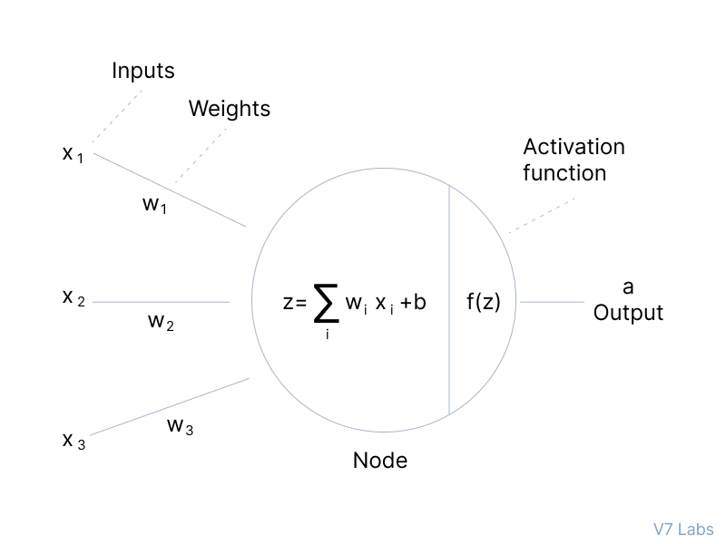
Activation Function
Depending on the nature and intensity of these input signals, the brain processes them and decides whether the neuron should be activated (“fired”) or not.
In deep learning, this is also the role of the Activation Function—that’s why it’s often referred to as a Transfer Function in Artificial Neural Network.
The primary role of the Activation Function is to transform the summed weighted input from the node into an output value to be fed to the next hidden layer or as output.
The purpose of an activation function is to add non-linearity to the neural network.

Slide 33
Role of Activation Function
Activation functions introduce an additional step at each layer during the forward propagation, but its computation is worth it. Here is why—
Let’s suppose we have a neural network working without the activation functions.
In that case, every neuron will only be performing a linear transformation on the inputs using the weights and biases.
It’s because it doesn’t matter how many hidden layers we attach in the neural network; all layers will behave in the same way because the composition of two linear functions is a linear function itself.
Although the neural network becomes simpler, learning any complex task is impossible, and our model would be just a linear regression model.

Slide 34
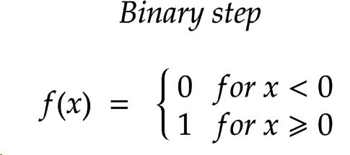
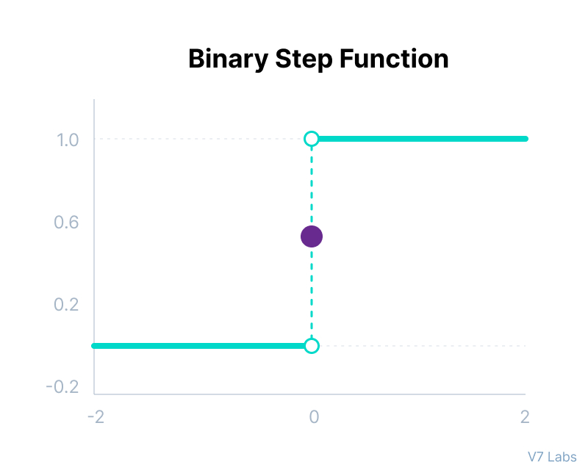
Types of Neural Networks Activation Functions
Binary step function depends on a threshold value that decides whether a neuron should be activated or not.
The input fed to the activation function is compared to a certain threshold; if the input is greater than it, then the neuron is activated, else it is deactivated, meaning that its output is not passed on to the next hidden layer.
Limitations:
It cannot provide multi-value outputs—for example, it cannot be used for multi-class classification problems.
The gradient of the step function is zero, which causes a hindrance in the backpropagation process.

Slide 35
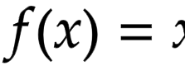
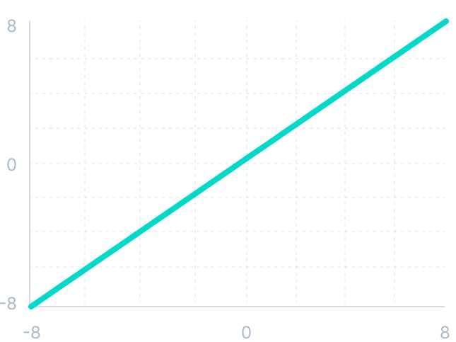
Linear Activation Function
The linear activation function, also known as "no activation," or "identity function" (multiplied x1.0), is where the activation is proportional to the input.
The function doesn't do anything to the weighted sum of the input, it simply spits out the value it was given.
However, a linear activation function has two major problems :
It’s not possible to use backpropagation as the derivative of the function is a constant and has no relation to the input x.
All layers of the neural network will collapse into one if a linear activation function is used. No matter the number of layers in the neural network, the last layer will still be a linear function of the first layer. So, essentially, a linear activation function turns the neural network into just one layer.
Mathematically, it can be represented as
Graphically, it can be represented as

Slide 36
Non-Linear Activation Functions
The linear activation function shown above is simply a linear regression model.
Because of its limited power, this does not allow the model to create complex mappings between the network’s inputs and outputs.
Non-linear activation functions solve the following limitations of linear activation functions:
They allow backpropagation because now the derivative function would be related to the input, and it’s possible to go back and understand which weights in the input neurons can provide a better prediction.
They allow the stacking of multiple layers of neurons as the output would now be a non-linear combination of input passed through multiple layers. Any output can be represented as a functional computation in a neural network.
Non-Linear activation functions are- Sigmoid, Tanh, ReLU, Leaky ReLu etc.

Slide 37
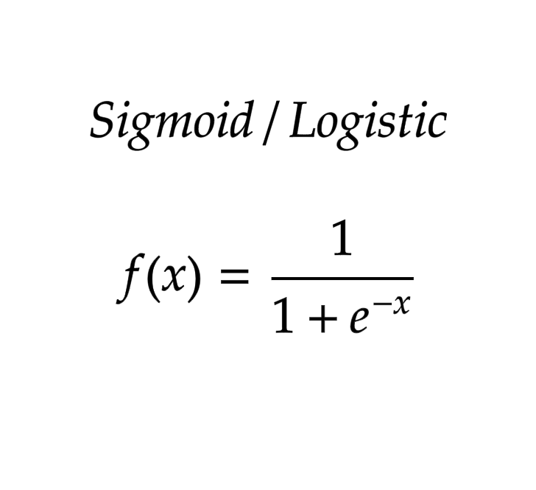
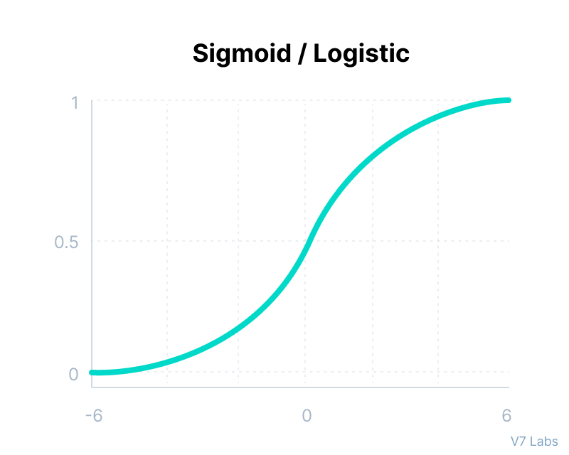
Sigmoid / Logistic Activation Function
This function takes any real value as input and outputs values in the range of 0 to 1.
The larger the input (more positive), the closer the output value will be to 1.0, whereas the smaller the input (more negative), the closer the output will be to 0.
Here’s why sigmoid/logistic activation function is one of the most widely used:
It is commonly used for models where we have to predict the probability as an output. Since probability of anything exists only between the range of 0 and 1, sigmoid is the right choice because of its range.
The function is differentiable and provides a smooth gradient, i.e., preventing jumps in output values. This is represented by an S-shape of the sigmoid activation function.
Mathematically, it can be represented as
Graphically, it can be represented as

Slide 38
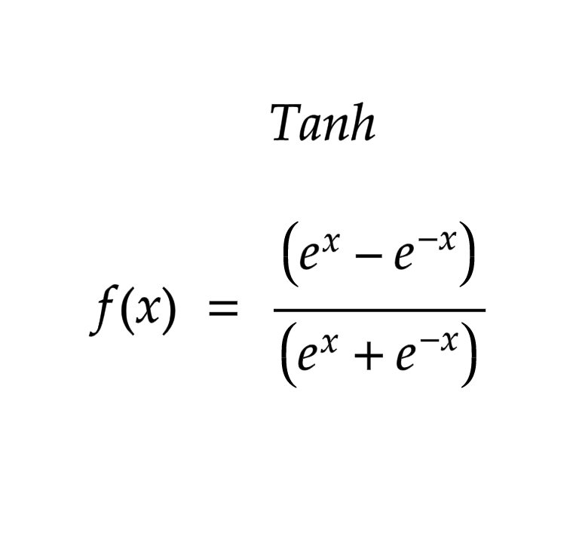
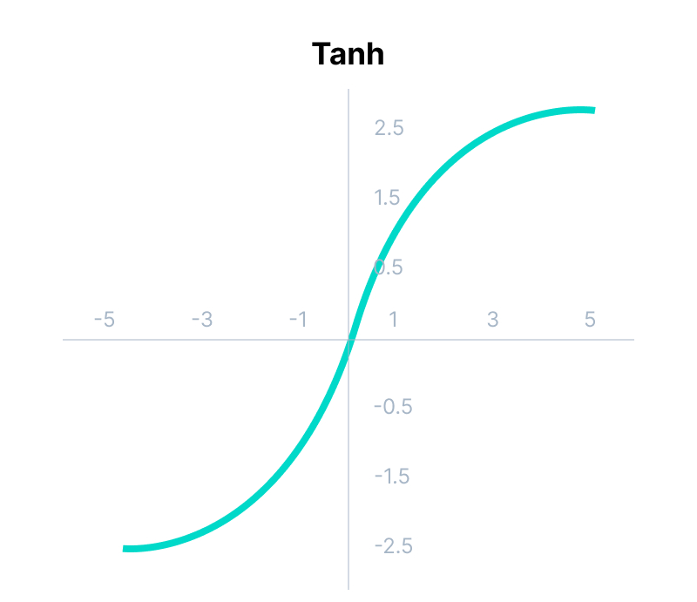
Tanh Function (Hyperbolic Tangent)
Tanh function is very similar to the sigmoid/logistic activation function, and even has the same S-shape with the difference in output range of -1 to 1. In Tanh, the larger the input (more positive), the closer the output value will be to 1.0, whereas the smaller the input (more negative), the closer the output will be to -1.0.
Advantages of using this activation function are:
The output of the tanh activation function is Zero centered; hence we can easily map the output values as strongly negative, neutral, or strongly positive.
Usually used in hidden layers of a neural network as its values lie between -1 to; therefore, the mean for the hidden layer comes out to be 0 or very close to it. It helps in centering the data and makes learning for the next layer much easier.
Mathematically, it can be represented as
Graphically, it can be represented as

Slide 39

Softmax Activation Function
Softmax allows CNNs to output a probability distribution over the possible classes. This is important because it allows the CNN to make more accurate predictions.
Softmax works by first normalizing the input vector so that all of the numbers in the vector sum to 1. Then, it exponentiates each number in the vector and divides by the sum of all of the exponentiated numbers. This results in a vector of probabilities, where each probability is between 0 and 1 and represents the probability that the input belongs to a particular class.
Here, the Z represents the values from the neurons of the output layer. The exponential acts as the non-linear function. Later these values are divided by the sum of exponential values in order to normalize and then convert them into probabilities.
The probability distribution output by the softmax function can then be used to make a more accurate prediction about the class of an input image.
For example, if the CNN is predicting whether an image contains a cat or a dog, the probability distribution can indicate how likely it is that the image contains a cat and how likely it is that the image contains a dog.
Softmax is typically used in the last layer of a neural network to predict the class of an input image. It is also used in other applications, such as natural language processing and machine translation.

Slide 40
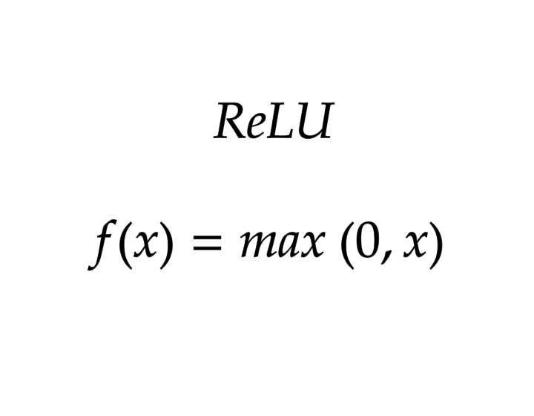
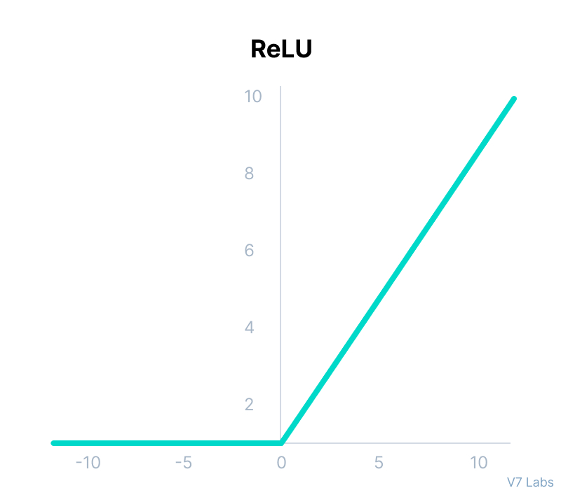
ReLU Function
ReLU stands for Rectified Linear Unit.
Although it gives an impression of a linear function, ReLU has a derivative function and allows for backpropagation while simultaneously making it computationally efficient.
The main catch here is that the ReLU function does not activate all the neurons at the same time.
The neurons will only be deactivated if the output of the linear transformation is less than 0.
The advantages of using ReLU as an activation function are as follows:
Since only a certain number of neurons are activated, the ReLU function is far more computationally efficient when compared to the sigmoid and tanh functions.
ReLU accelerates the convergence of gradient descent towards the global minimum of the loss function due to its linear, non-saturating property.
The limitations faced by this function are:
The Dying ReLU problem,
Mathematically, it can be represented as
Graphically, it can be represented as

Slide 41
Dying ReLU
A dying ReLU always outputs the same value, i.e., 0, on any input value. This condition is known as the dead state of ReLU neurons.
In this state, it is difficult to recover because the gradient of 0 is 0. This becomes a problem when most of the input ranges are negative, or the derivative of the ReLU function is 0.
The gradient fails to flow during backpropagation because the outputs are 0, and hence the weights are not updated. In the worst case, we get a constant function where the entire neural network dies. A network is born dead if it is dead before training.
As long as all the inputs push ReLU to non-negative segments, the dying ReLU problem doesn't occur.
Causes of the dying ReLU
There are two major causes of the dying ReLU problem:
Setting high learning rates
Having a large negative bias

Slide 42
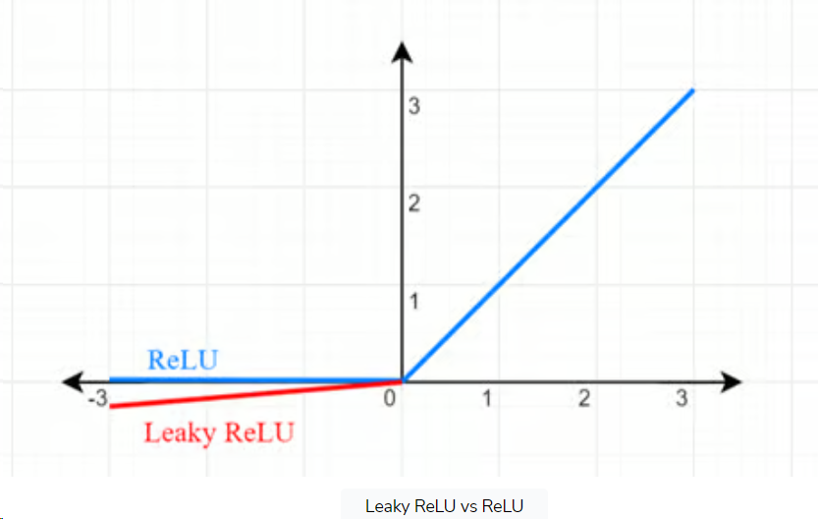
Leaky ReLU
Another popular technique is Leaky ReLU, as it solves the vanishing gradient problem and then converges fast. In the entire domain, Leaky ReLU has a non-zero gradient.
The slope is non-zero for the negative side in Leaky ReLU, which is not the case for general ReLU.
Hence, we have a small negative output for the negative input, which helps recover from the dying ReLU.
Some other techniques include the Parametric ReLU and exponential linear units.
f(x)=max(0.01x,x)

